Slide 1

CODET
“Coding the feature of humanity !”

Slide 2
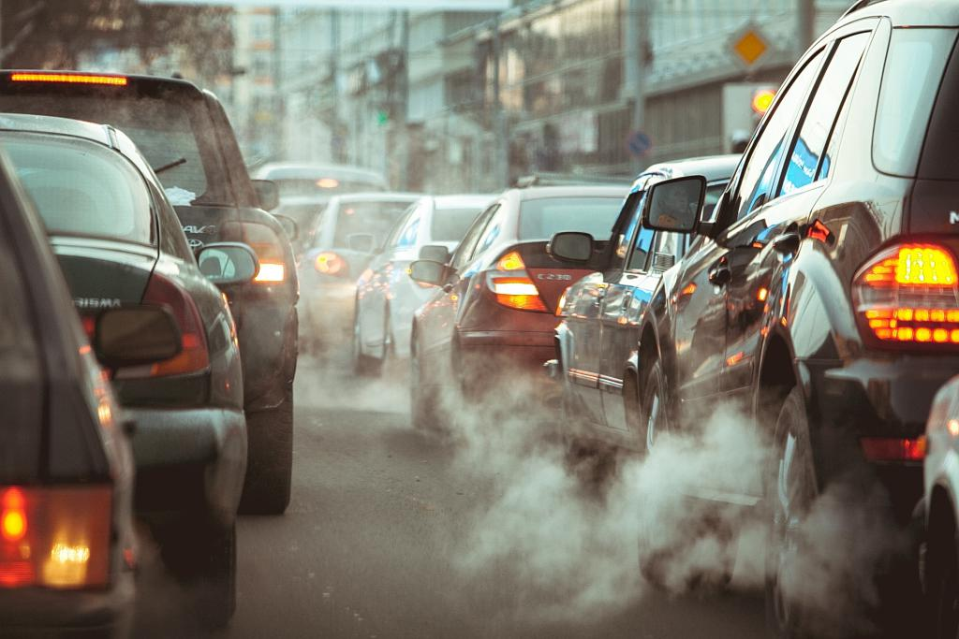
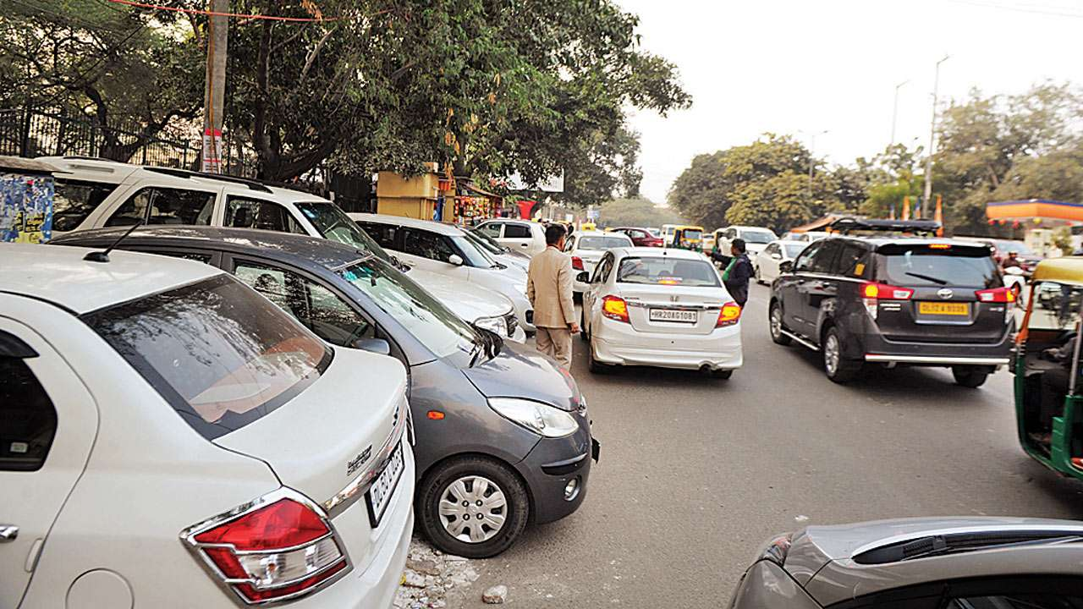
PROBLEM
The waste of time is very effective for today
Traffic congestion vehicles traveling unnecessarily
Accumulation of exhaust smoke in crowded places due to traffic and environmental pollution

Slide 3

SOLUTION
“Comfortable parking with a reliable system”
We intend to save our users from confusion and time loss with our mobile application.

Slide 4
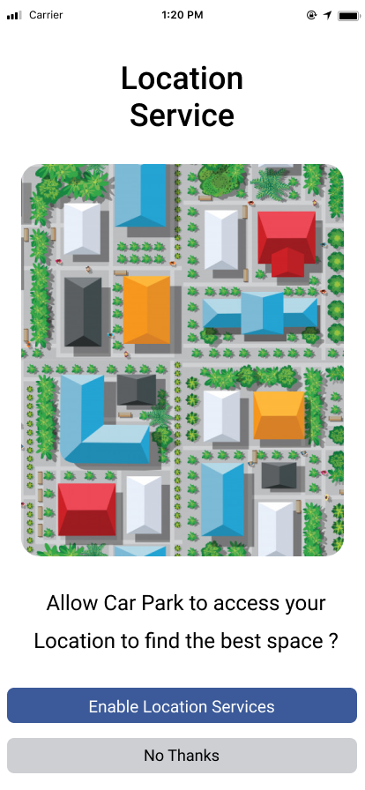
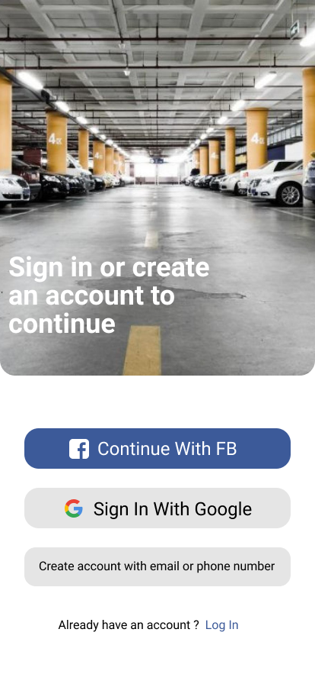
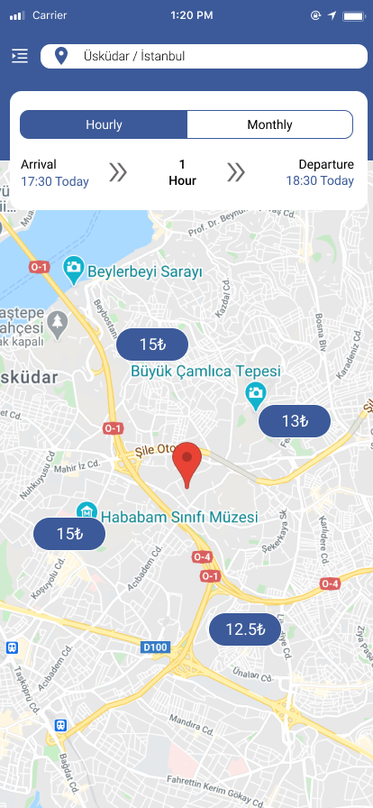
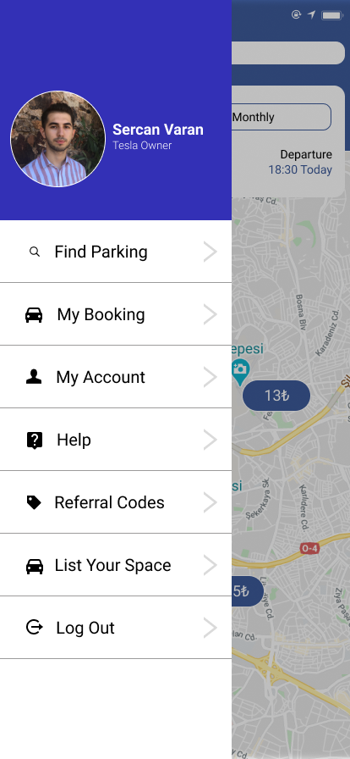
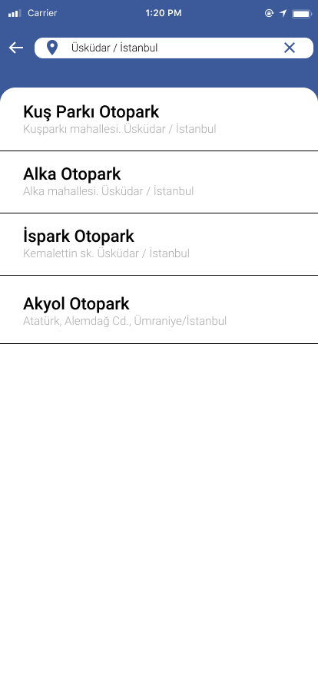
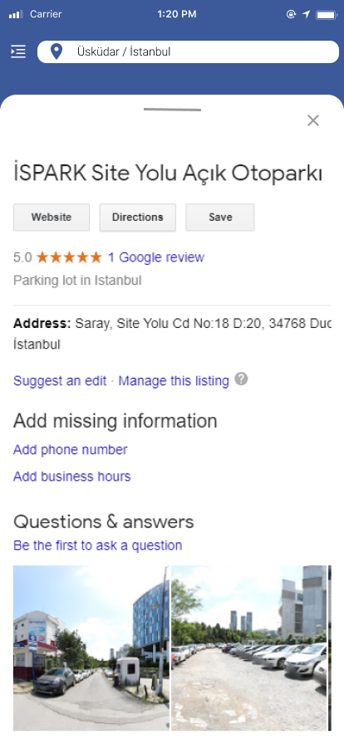
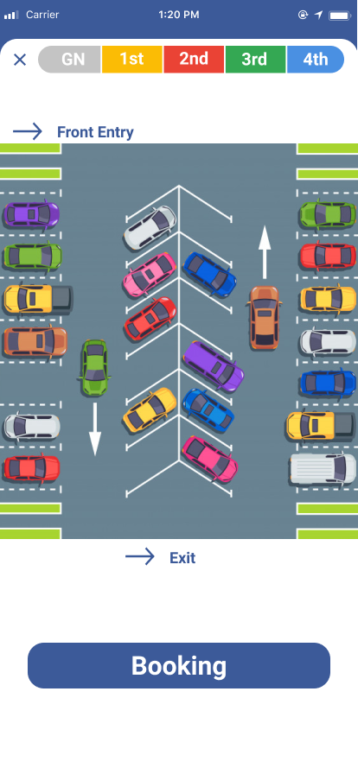
COMPONENTS

Slide 5
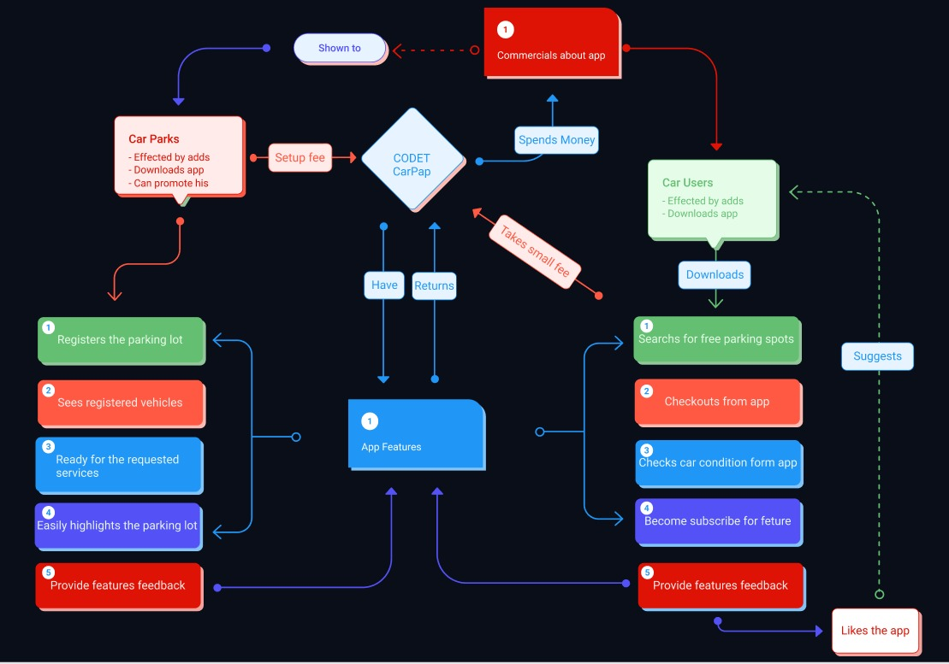

Slide 6
Opportunity and target market
With the increase in the number of vehicles, there is an increase in demand.
Our potential customers all vehicle owners who value their time, are compatible with technology and are over 18 years old.

Slide 7

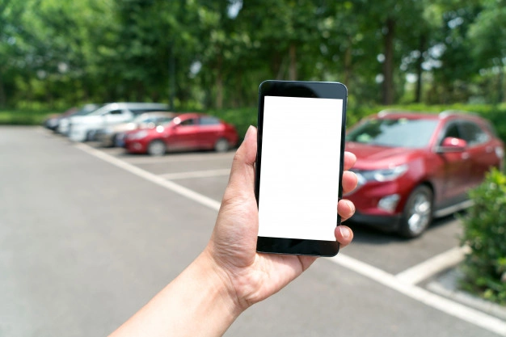

Technology

Slide 8
Competition
There is little or no competition in our field, but as a result of our long research we found similar products. But our difference does not depend on the user we deal with car parks for our users. It can be predicted that our application will grow rapidly at the lowest competition and then become a fully self-sufficient company and control it within this framework in competition.

Slide 9
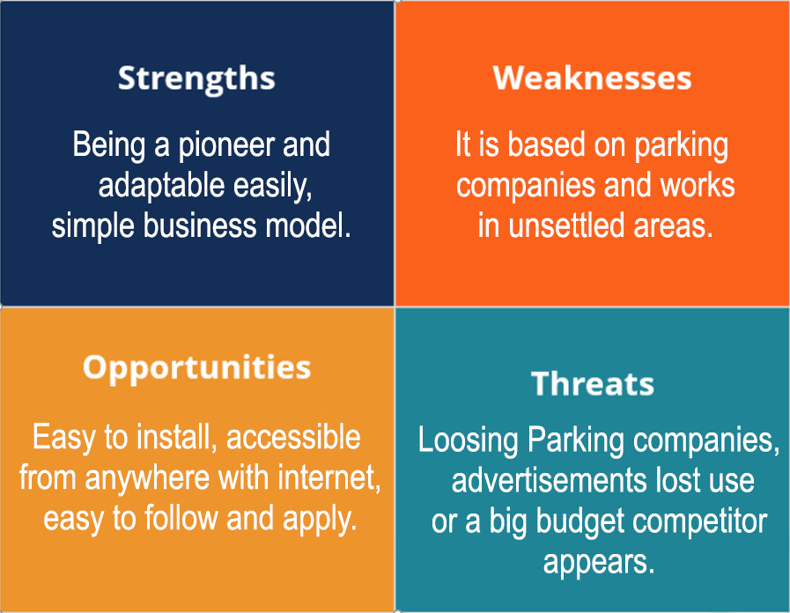
SWOT Analysis

Slide 10
Marketing and sales
Our potential customers all vehicle owners who value their time, are compatible with technology and are over 18 years old.
Being fast and efficient is our first strategy which ends up with more download and end-user for us. Thus, the program will sell itself with the usage of numbers at people. The priority of our operation plan is to make the user-based parts of our application ready for presentation and to announce it and to reach more customers by advancing our agreements with parking lot owners.

Slide 11
Management team
Co-Founder & CTO - Cafer S.Yükseloğlu | Advertisement Manager - Sercan Varan | Back-end Developer -Tamer Ünal | Front-end Developer -Oğuzhan Karabey
Graphic Designer -Beyza Kurşun | Marketing Manager -Melike Avşar | Customer Service Manager - Sena Uluçam

Slide 12
Financial projections
These fees are the required fees to keep our project effective and useful. Design Fee : It is the fee that we pay to make our program more attractive via designs, graphics.
Programming Fee: Which is one of our biggest expenses, is the fee that we give to the programmer for the software of our product.
Server Fee : We will host our application on a server. We have to pay regular server fees.
Office Rent : Since we will manage our business from an office, we must rent an office. For this reason, we need to have an office rental fee.
Company Set-up Fees : Entire taxes and legal fees required for the establishment of the company.
Advertising Fee: It is the budget allocated for the promotion of the product to consumers in different media.
Hardware Fees : One of the biggest expenses of a software company is hardware expenses because the ,computer and internet are used for this project.

Slide 13
Current status
Currently we are developing our program to make more attractive program via design or availability. Then we will try to contact with car parks.

Slide 14
Financing sought
Until we catch our potential we are aiming for the cuts in financial gain, but it can easily be brought to life after a certain period of time with a customer-based version index.
As we said we do not aim for an financial gain until we catch our potential, we are using financial power to reach more users via design, advertisement and more available program.

Slide 15
Summary
We are happy to have you here and we appreciate for your concern. Now we are waiting for questions.

